Slide 1
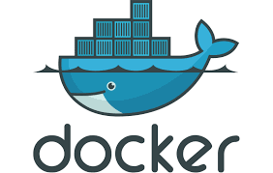
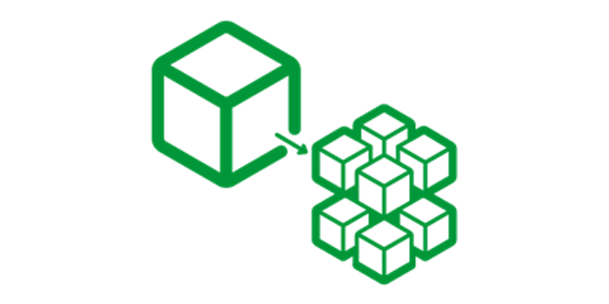
Microservices and Docker

Slide 2
Agenda
Microservices Basics, Monolithic to Microservices
Spring Cloud
Introduction to Docker

Slide 3
Microservices
The microservice architectural style is an approach to develop a single application as a suite of small services.
Each microservice runs its process and communicates with lightweight mechanisms.
These services are built around business capabilities and independently developed by fully automated deployment machinery

Slide 4
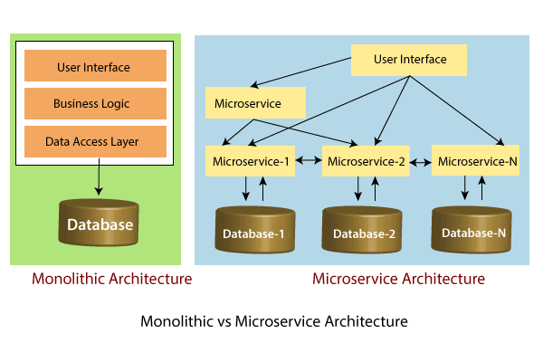

Slide 5
Principles of Microservices
Single Responsibility principle
Modelled around business domain
Isolate Failure
Infrastructure automation
Deploy independently

Slide 6
Advantages of Microservices
Microservices are self-contained, independent deployment module.
The cost of scaling is comparatively less than the monolithic architecture.
Microservices are independently manageable services. It can enable more and more services as the need arises. It minimizes the impact on existing service.
It is possible to change or upgrade each service individually rather than upgrading in the entire application

Slide 7
Disadvantages of Microservices
Microservices has all the associated complexities of the distributed system.
There is a higher chance of failure during communication between different services.
Difficult to manage a large number of services.
The developer needs to solve the problem, such as network latency and load balancing.
Complex testing over a distributed environment.

Slide 8
Challenges of Microservices Architecture
Bounded Context
Dynamic Scale up and Scale Down
Monitoring
Fault Tolerance
Cyclic dependencies
DevOps Culture

Slide 9
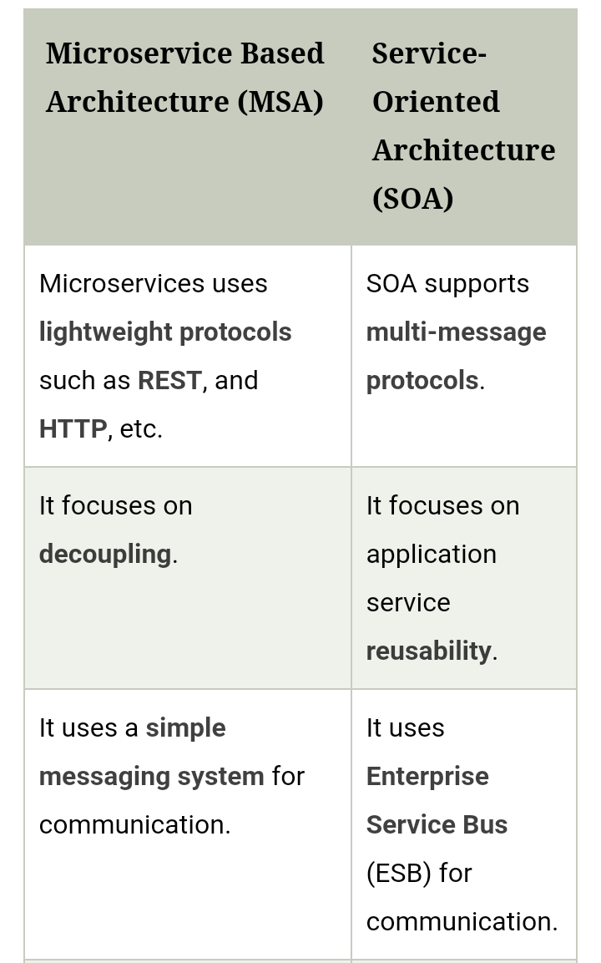
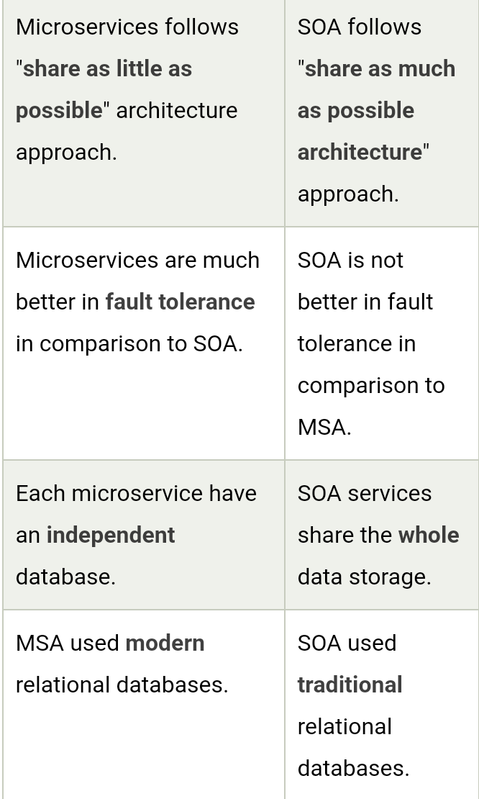

Slide 10
Microservices Monitoring
Monitor container and what's inside them.
Alert on service performance.
Monitor services that are elastic and multi-location.
Monitor APIs.
Monitor the organizational structure

Slide 11
There are three monitoring tools are as follows:
Hystrix dashboard
Eureka admin dashboard
Spring boot admin dashboard

Slide 12
Components of Microservices
There are the following components of microservices:
Spring Cloud Config Server
Netflix Eureka Naming Server
Hystrix Server
Netflix ZuulAPI Gateway Server
Netflix Ribbon
Zipkin Distributed Tracing Server

Slide 13
Spring Cloud Config Server
Spring Cloud Config Server provides the HTTP resource-based API for external configuration in the distributed system.
We can enable the Spring Cloud Config Server by using the annotation @EnableConfigServer.

Slide 14
Netflix Eureka Naming Server
Netflix Eureka Server is a discovery server. It provides the REST interface to the outside for communicating with it.
A microservice after coming up, register itself as a discovery client.
The Eureka server also has another software module called Eureka Client.
Eureka client interacts with the Eureka server for service discovery.
The Eureka client also balances the client requests.

Slide 15
Hystrix Server
Hystrix server acts as a fault-tolerance robust system. It is used to avoid complete failure of an application.
It does this by using the Circuit Breaker mechanism. If the application is running without any issue, the circuit remains closed.
If there is an error encountered in the application, the Hystrix Server opens the circuit.
The Hystrix server stops the further request to calling service. It provides a highly robust system.

Slide 16
Hystrix Server
Hystrix server acts as a fault-tolerance robust system. It is used to avoid complete failure of an application.
It does this by using the Circuit Breaker mechanism. If the application is running without any issue, the circuit remains closed.
If there is an error encountered in the application, the Hystrix Server opens the circuit.
The Hystrix server stops the further request to calling service. It provides a highly robust system.

Slide 17
Netflix Zuul API Gateway Server
Netflix Zuul Server is a gateway server from where all the client request has passed through. It acts as a unified interface to a client.
It also has an inbuilt load balancer to load the balance of all incoming request from the client.

Slide 18
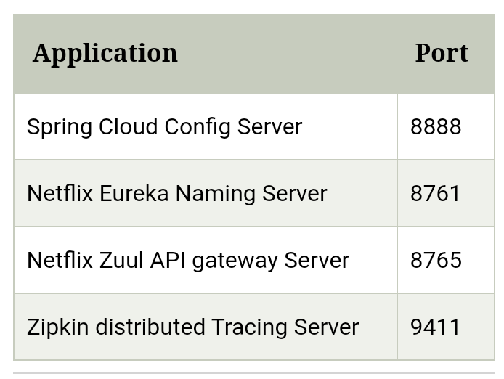

Slide 19
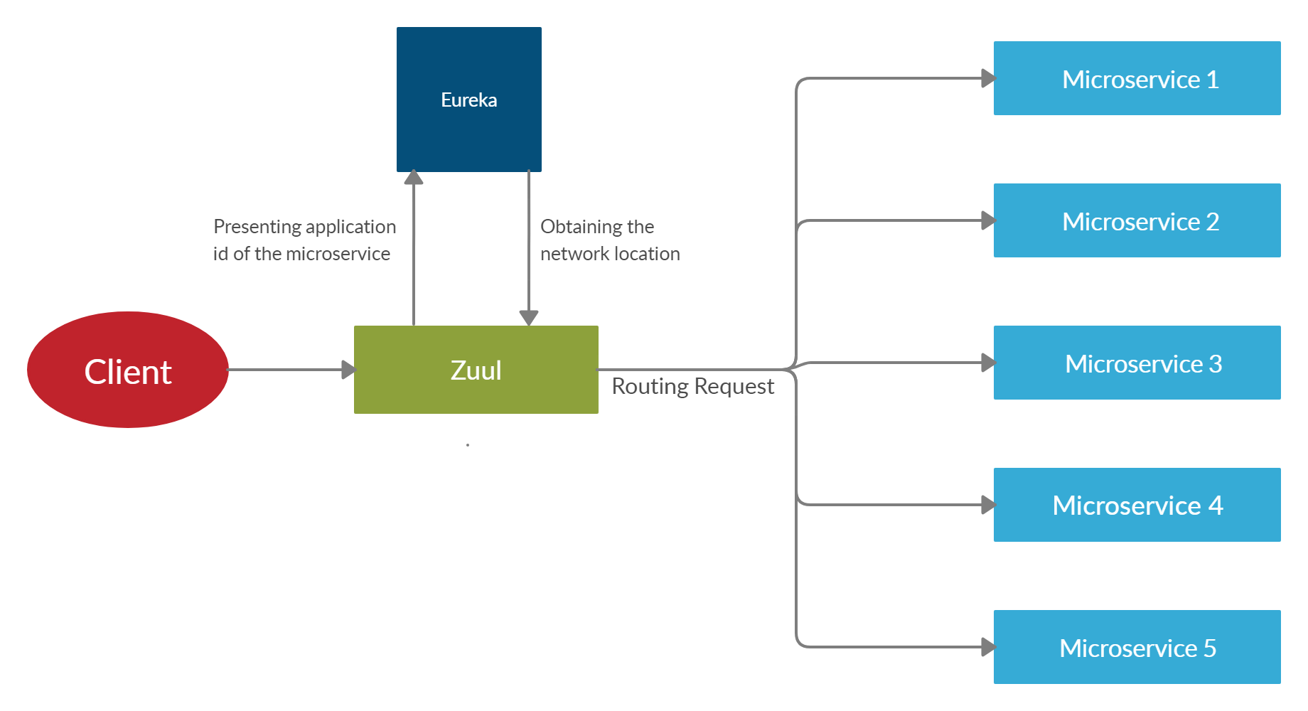

Slide 20
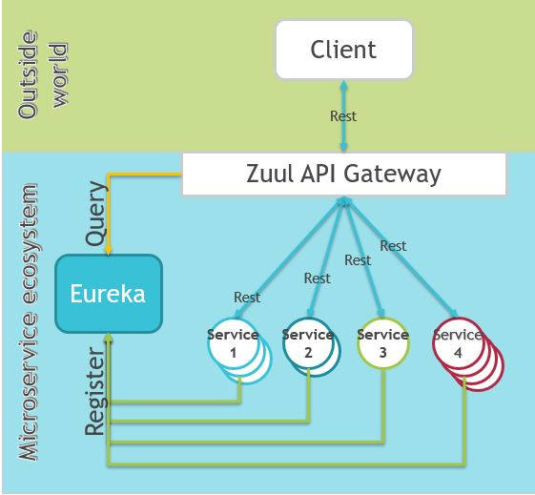

Slide 21
Sample coding

Slide 22
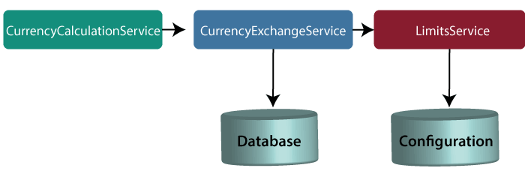

Slide 23
NetflixEurekaNamingServerApplication.java

Slide 24
NetflixEurekaNamingServerApplication.java
import org.springframework.boot.SpringApplication;
import org.springframework.boot.autoconfigure.SpringBootApplication;
import org.springframework.cloud.netflix.eureka.server.EnableEurekaServer;
@SpringBootApplication
@EnableEurekaServer
public class NetflixEurekaNamingServerApplication
{
public static void main(String[] args) {
SpringApplication.run(NetflixEurekaNamingServerApplication.class, args);
}
}

Slide 25
application.properties
spring.application.name=netflix-eureka-naming-server
server.port=8761
eureka.client.register-with-eureka=false
eureka.client.fetch-registry=false

Slide 26
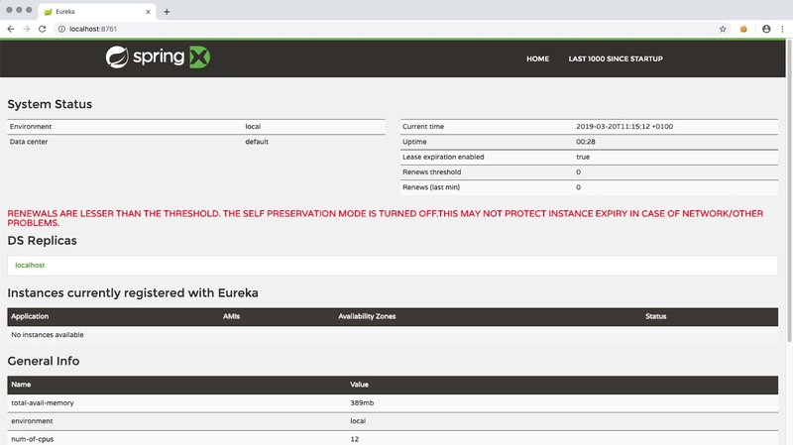

Slide 27
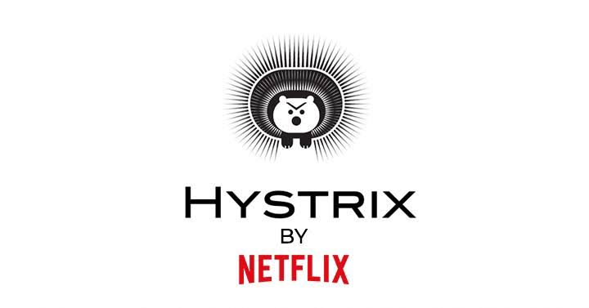

Slide 28

Hystrix Server
Hystrix server acts as a fault-tolerance robust system. It is used to avoid complete failure of an application.
It does this by using the Circuit Breaker mechanism. If the application is running without any issue, the circuit remains closed.
If there is an error encountered in the application, the Hystrix Server opens the circuit.
The Hystrix server stops the further request to calling service. It provides a highly robust system.

Slide 29
Fault Tolerance with Hystrix
Microservices must be extremely reliable because they depend on each other.
The microservice architecture contains a large number of small microservices.
These microservices communicate with each other in order to fulfill their requirements.
The instances of microservices may go up and down frequently.
As the number of interactions between microservices increases, the chances of failure of the microservice also increases in the system.

Slide 30
Fault Tolerance
Consider a scenario in which six microservices are communicating with each other.
The microservice-5 becomes down at some point, and all the other microservices are directly or indirectly depend on it, so all other services also go down.
The solution to this problem is to use a fallback in case of failure of a microservice. This aspect of a microservice is called fault tolerance

Slide 31
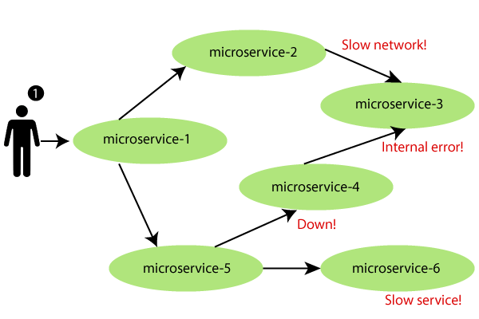

Slide 32
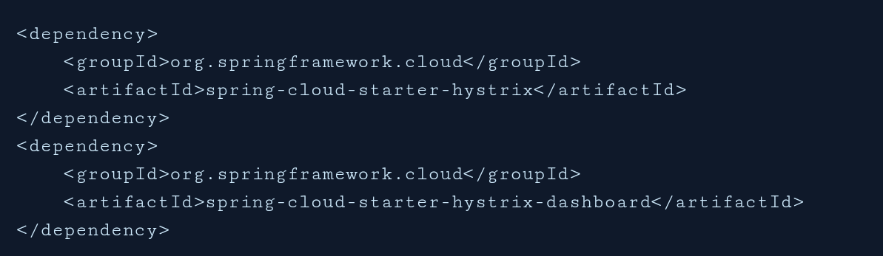
Hystrix configuration is done in four major steps.
Add Hystrix starter and dashboard dependencies
Add @EnableCircuitBreaker annotation
Add @EnableHystrixDashboard annotation
Add annotation @HystrixCommand(fallbackMethod = "myFallbackMethod")

Slide 33
Hystrix Circuit Breaker Pattern
Fault tolerance can be achieved with the help of a circuit breaker.
It is a pattern that wraps requests to external services and detects when they fail.
If a failure is detected, the circuit breaker opens.All the subsequent requests immediately return an error instead of making requests to the unhealthy service.
It monitors and detects the service which is down and misbehaves with other services. It rejects calls until it becomes healthy again

Slide 34
Hystrix Circuit Breaker Pattern – Spring Cloud
the Spring cloud Netflix stack component called Hystrix to implement circuit breaker while invoking underlying microservice.
It is generally required to enable fault tolerance in the application where some underlying service is down/throwing error permanently, we need to fall back to different path of program execution automatically.
This is related to distributed computing style of Eco system using lots of underlying Microservices. This is where circuit breaker pattern helps and Hystrix is an tool to build this circuit breaker.

Slide 35
Fallback method
The fallback method is a method that invokes when a fault occurs.
Hystrix allows us to define a fallback method for each service method

Slide 36
Sample coding

Slide 37
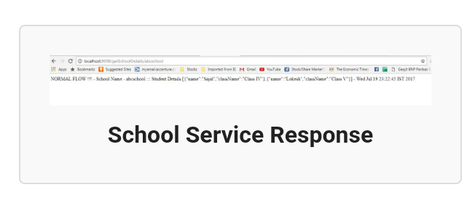

Slide 38
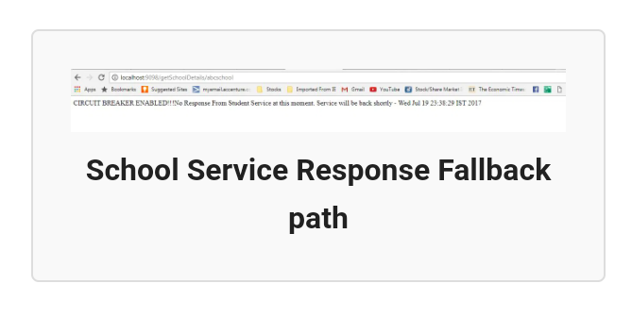

Slide 39
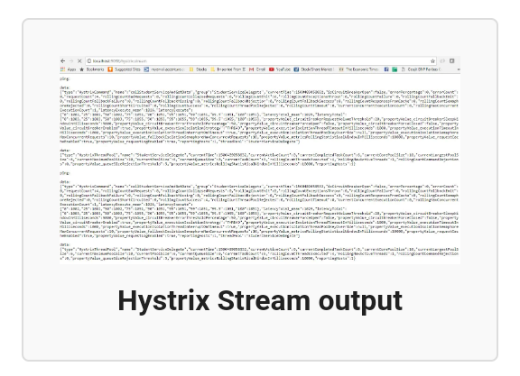

Slide 40
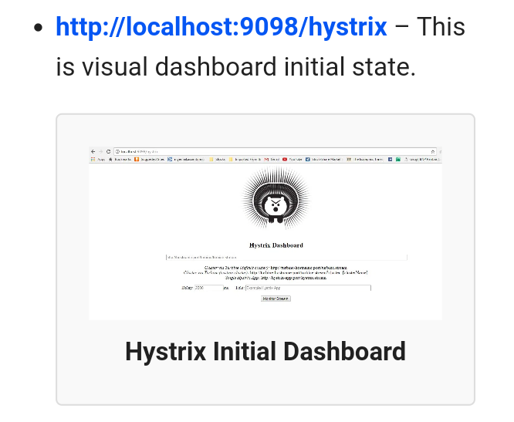

Slide 41
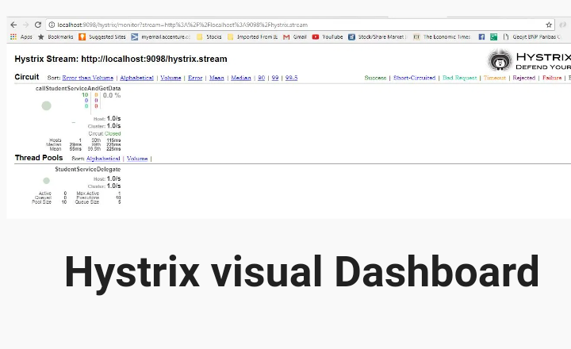

Slide 42
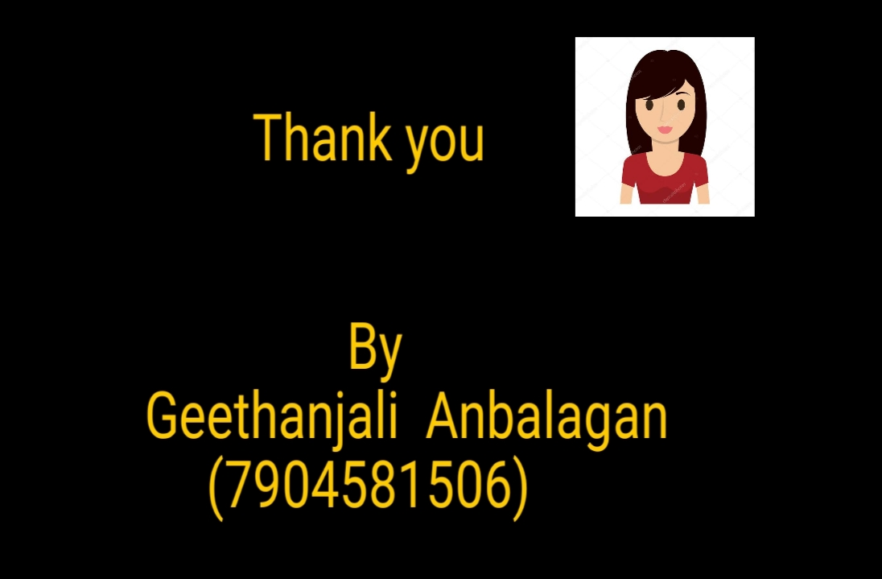

Slide 47
